Slide 1

GOVERNMENT COLLEGE OF ENGINEERING
SALEM-11
TOPIC : WEB SCRAPING : DATA HARVESTING MASTERY
TEAM MEMBERS : GUIDE NAME
MOHAN RAJ.R (61772221L03) Dr .P. NITHYA
LINGESH. G (61772221L02)
LEJESH. K (61772221T305)

Slide 2

PROBLEM STATEMENT
Extracting data from websites, offering numerous benefits in various domains such as business intelligence, research, and market analysis.

Slide 3
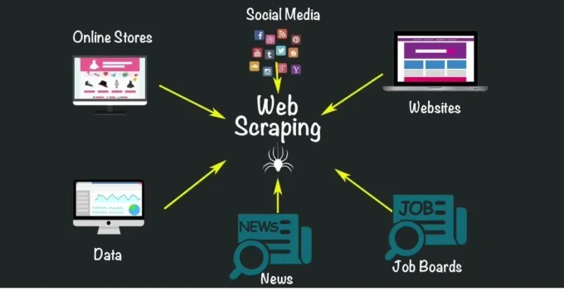
OBJECTIVES
Market Rese
Competitor Analysis
Price Monitoring
Academic Purpose
Research

Slide 4

MOTIVATION
Data Collection
Real-time Data updates
Research Purpose
Historical Data Collection
Efficient Price Comparison

Slide 5


TARGET USERS
Travel Industry
Business Analysts
Market Researchers

Slide 6
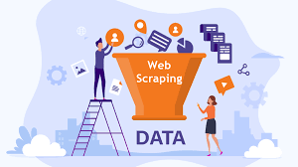
ABSTRACT
Web Scraping is the method of extracting data from websites in an automated way.
Web scraping to obtain large amounts of data from websites. Most of this data is unstructured data in an HTML format which is then converted into structured data in a spread sheet or database so that it can be used in various applications.
High-quality web scraped data obtained in large volumes can be very helpful for companies in analyzing consumer trends and understanding which direction the company should move in the future.

Slide 7
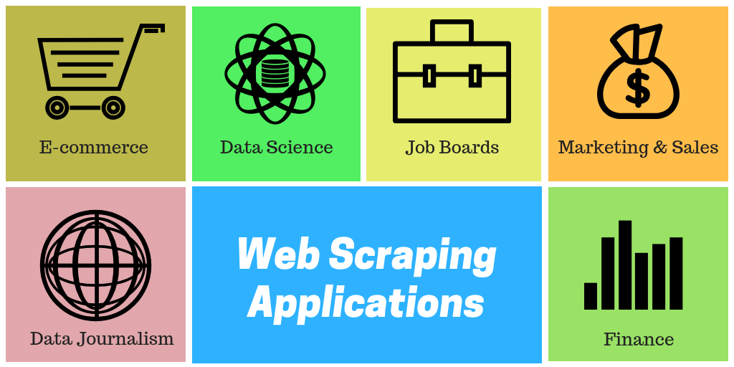
INTRODUCTION
Web scraping (web harvesting or web data extraction) is a computer software technique of extracting information from websites.
Web scraping typically targets one web site at a time to extract unstructured information and put it in a structured form for reuse.
Web Scraping can be used by companies to scrap the product data for their products and competing products as well to see how it impacts their pricing strategies.
Companies can use this data to fix the optimal pricing for their products so that they can obtain maximum revenue.

Slide 8
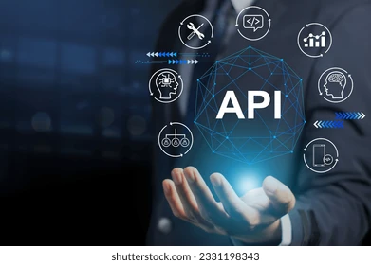

EXISITING SYSTEM
Manual Data Entry.
API(Application Programming Interfaces)
Data Dumps and Downloads
Contacting the Website Owner
Publicly Available Datasets

Slide 9

Algorithm
Parsing Algorithms
TECHNIQUES:
HTTP Requests
Regex.

Slide 10

PROPOSED SYSTEM
customized to meet specific scraping needs and business requirements.
Extracting the large amount of data very easily.
Web scraping allows for precise extraction of structured data from websites, ensuring high accuracy compared to manual methods and eliminate human errors.

Slide 11
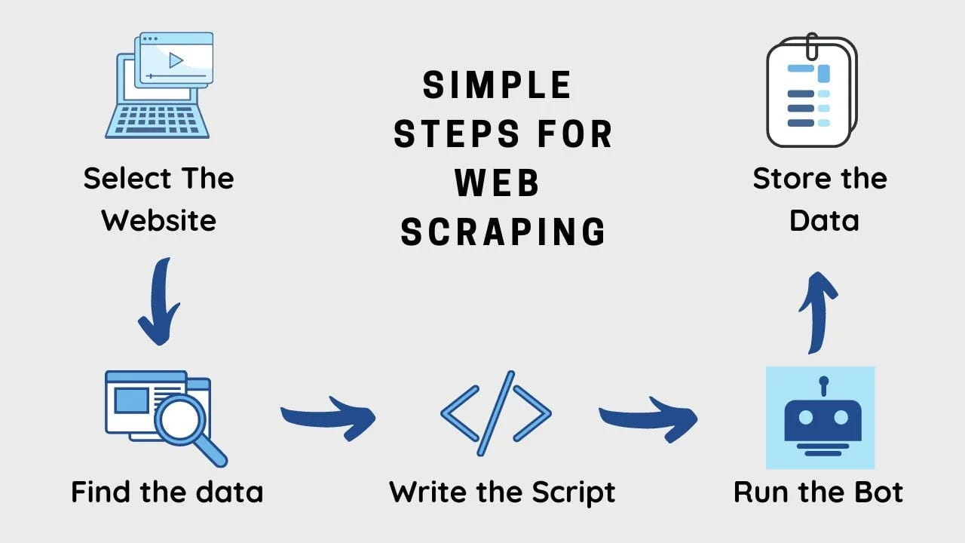
ARCHITECTURE

Slide 12

HARDWARE REQUIREMENT
RAM: 6GB .
STORAGE : The amount of storage required depends on the volume of data being collected. Solid-state drives (SSDs) are preferred over HDD.
PROCESSOR :intel i3 or Higher versions preffered.

Slide 13
SOFTWARE REQUIRED
IDE :Google colab.
PACKAGES:
‘requests’ package : used to requesting the website.
Beautiful Soup is a library that is commonly used for web scraping purposes.
SqlLite3 : used to convert database.

Slide 14


